Slide 1
Practice Questions
– For Loop-

Slide 2
◈ Write a python program to print the square
Question 01
of all numbers from 0 to 11.
0 to 9

Slide 3



Slide 4
◈ Write a python program to find the sum of all even numbers from 0 to 10.
Question 02

Slide 5
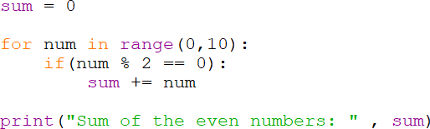

Slide 6
Question 03
◈ Write a python program to read three numbers (a, b, c) and check how many numbers between ‘a’ and ‘b’ are divisible by ‘c’. (Assume b is not getting included)

Slide 7
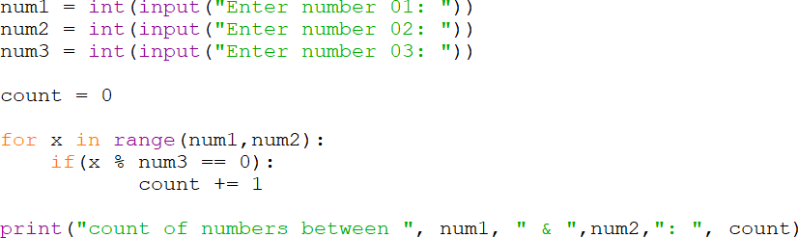

Slide 8
◈ Write a python program to get the following output.
Question 04
1 99
2 98
..
..
98 2
99 1

Slide 9
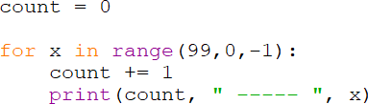

Slide 10
Question 05
◈ Create a multiplication table of a number entered by the user from 1 to 10 using for loop concept.

Slide 11
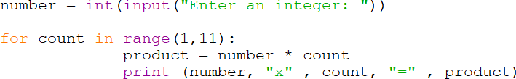

Slide 12
Question 06
◈ Print the reverse of the items in the list using range() function.
numList = [10,20,30,40,50]

Slide 13
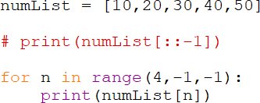

Slide 14

Question 07
◈ Write a python program to write the weekday names 3 times using nested loops as per the below output.

Slide 15
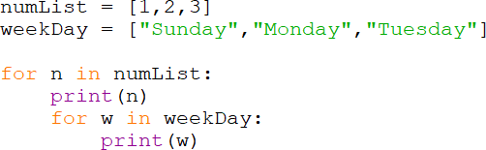

Slide 16
◈ Print your name in 3 rows and columns.
Question 08
Anne Anne Anne Anne Anne Anne Anne Anne Anne Anne Anne Anne

Slide 17
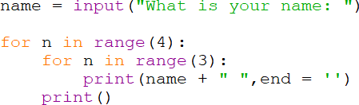

Slide 18
◈ Print the following pattern.
Question 09
*
* *
* * *
* * * *
* * * * *

Slide 19


Slide 20
◈ Print the following pattern.
Question 10
*
* *
* * *
* * * *
* * *
* *
*
20

Slide 21
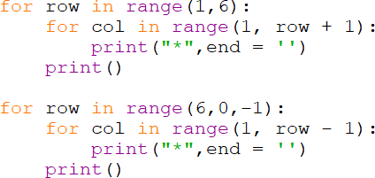
21

Slide 22
◈ Print the following pattern.
Question 11
1
1 2
1 2 3
1 2 3 4
1 2 3 4 5
22

Slide 23

23

Slide 24
◈ Print the following pattern.
Question 12
1
2 2
3 3 3
4 4 4 4
5 5 5 5 5
24

Slide 25

25

Slide 26
◈ Print the following pattern.
Question 13
*
* *
* * *
* * * *
26

Slide 27
Thanks!
Any questions?
27

